Slide 1

Welcome to Ankara unıversıty
Erasmus Office
Erasmus Institutional Coordinator
Assist. Prof. Cafer YILDIRIM

Slide 2
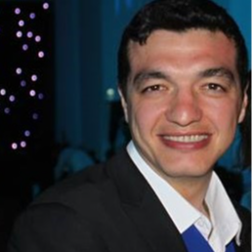
About Me: Cafer YILDIRIM, AssIStAnt Professor
European UnIon EducatIonal Programes OffIce
ErasmusInstItutIonal CoordINAtor, Ankara UnIversIty
Education
Doctorate, Eskisehir Osmangazi University, Institute of Health Sciences, Medicinal Pharmacology(Dr), Turkey 2013 -2017
Undergraduate, Firat University, Faculty Of Veterınary Medıcıne,Veteriner Pr., Turkey 2000 - 2005
Experiences
Assistant Professor, Eskisehir Osmangazi University
Program Coordinator, Eskisehir Osmangazi University
Institutional Erasmus Coordinator, Eskisehir Osmangazi University

Slide 3
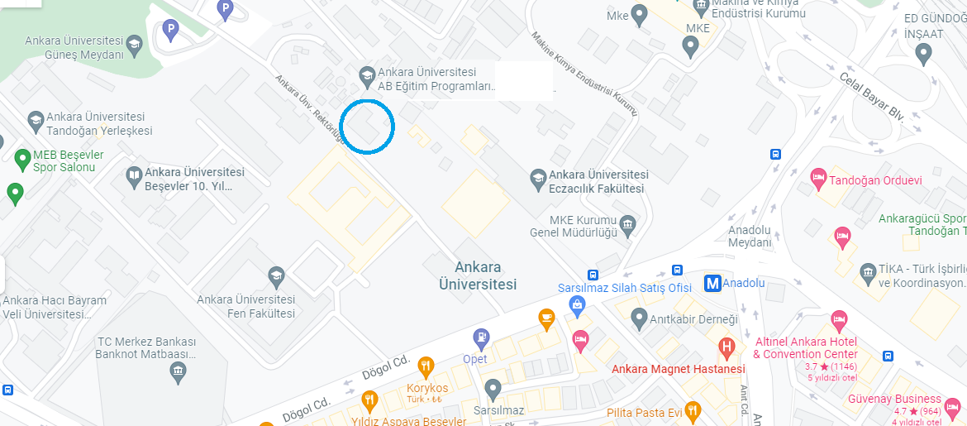
ERASMUS OFFICE Locatıon
Address: Dögol Street
Ankara University,
International Center,
Beşevler/ANKARA

Slide 4
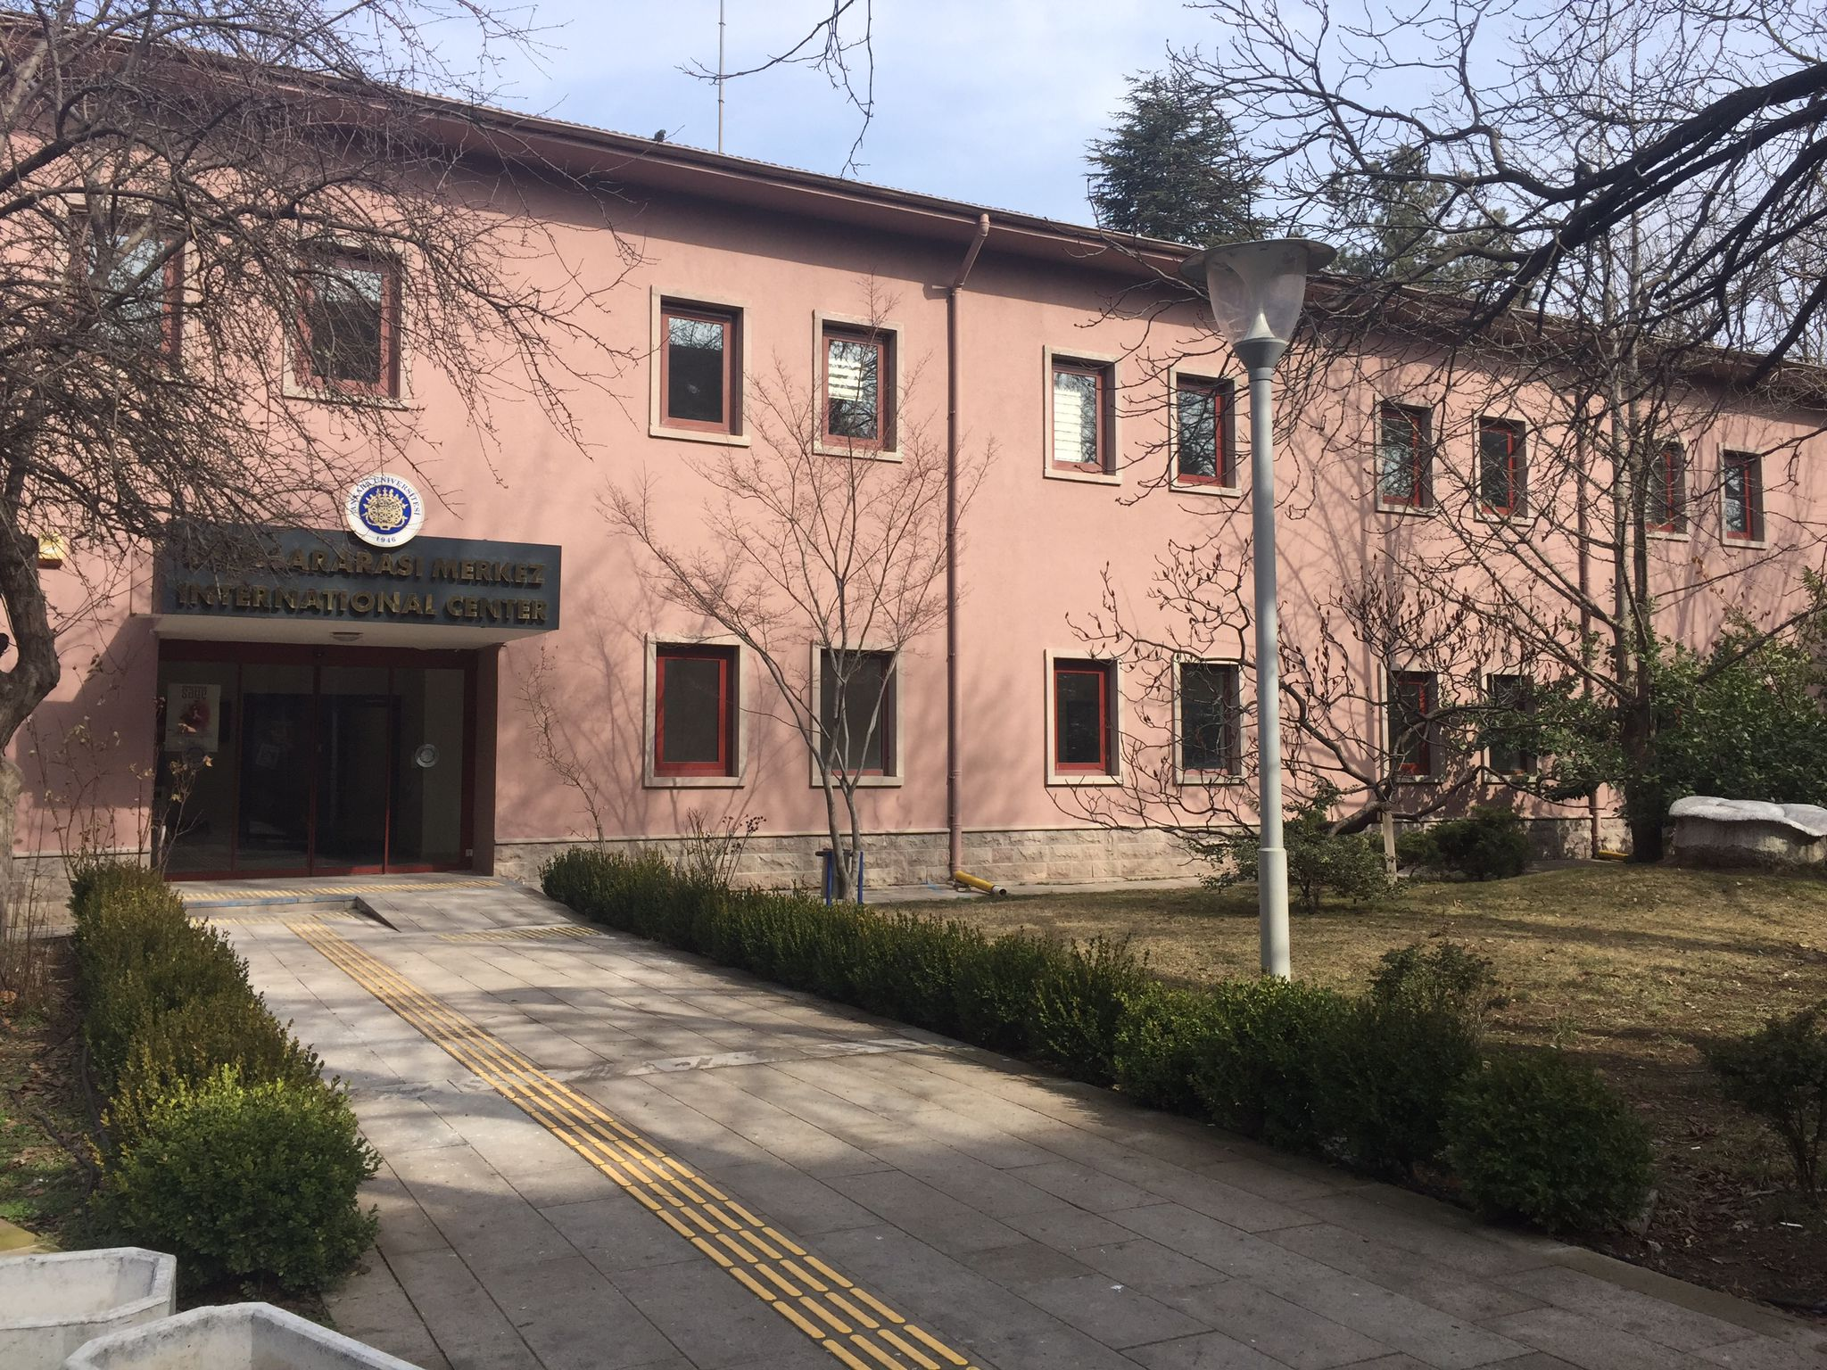
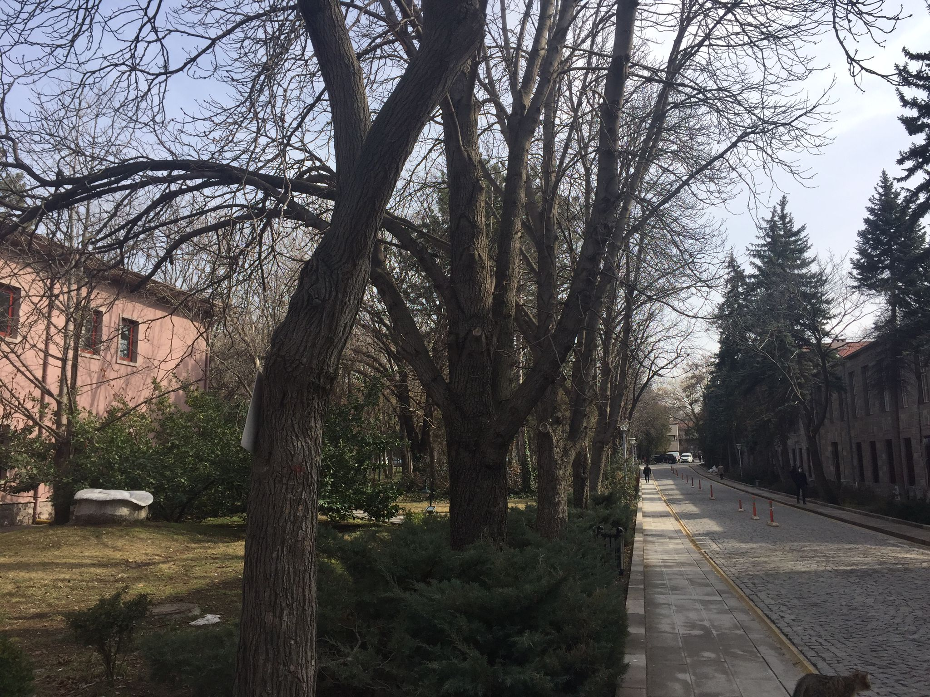
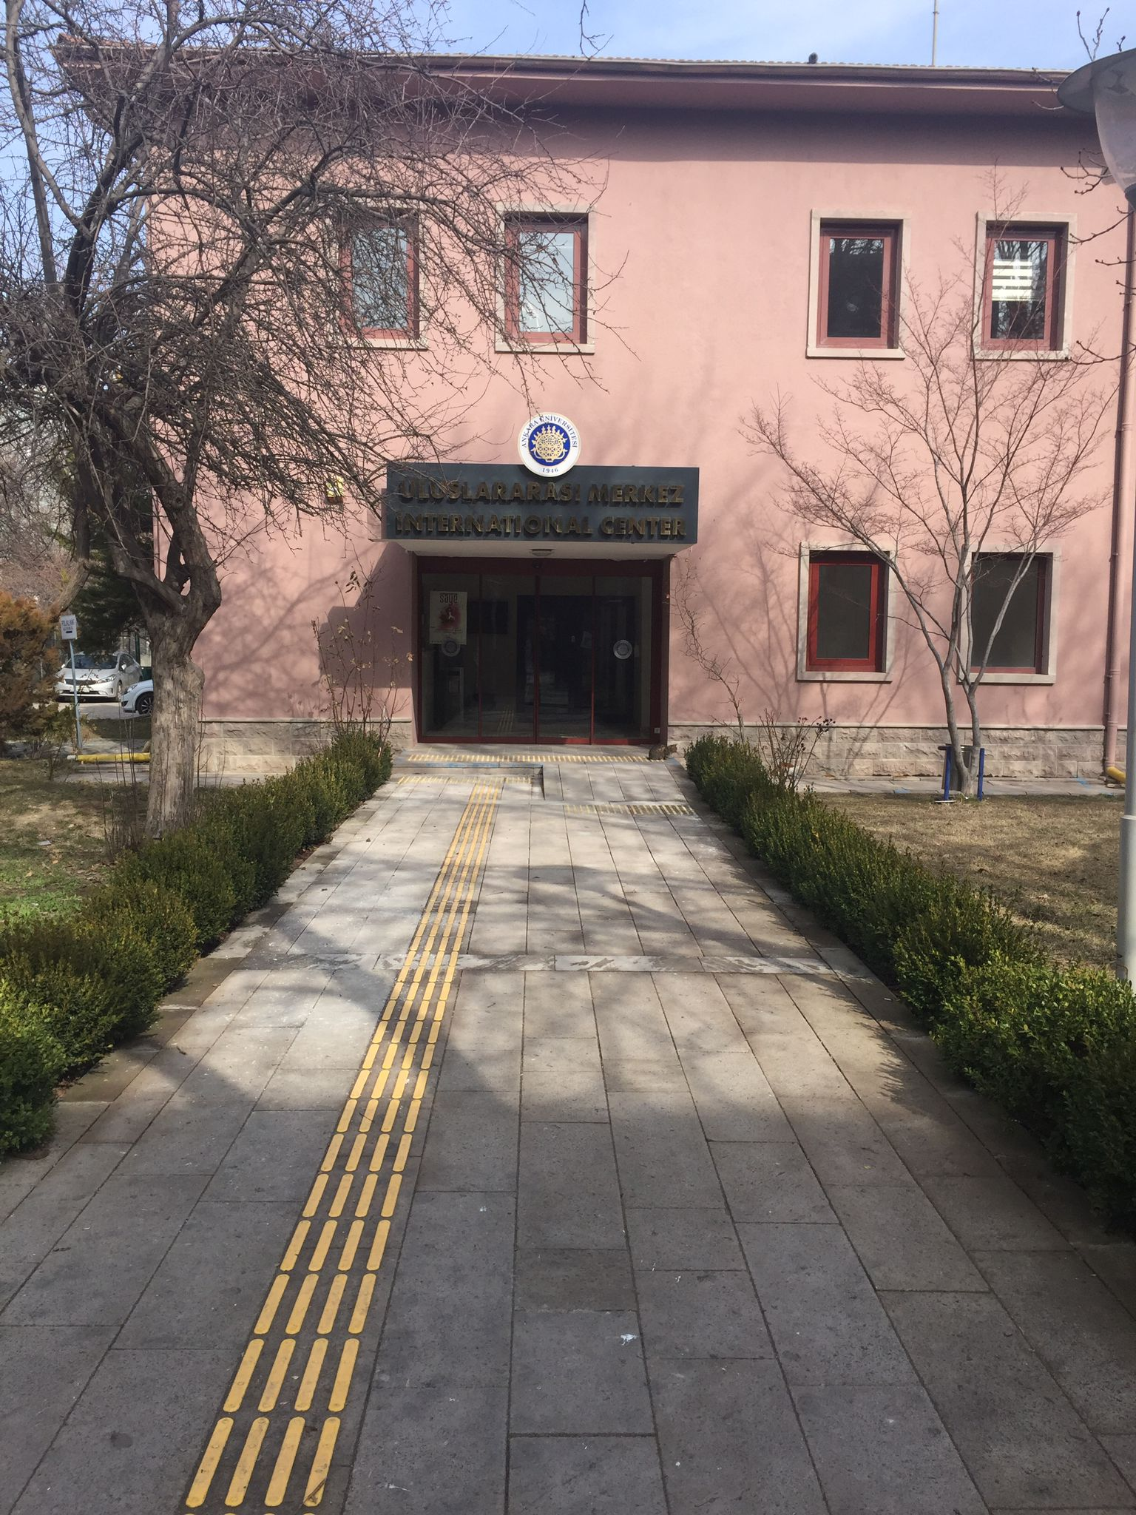
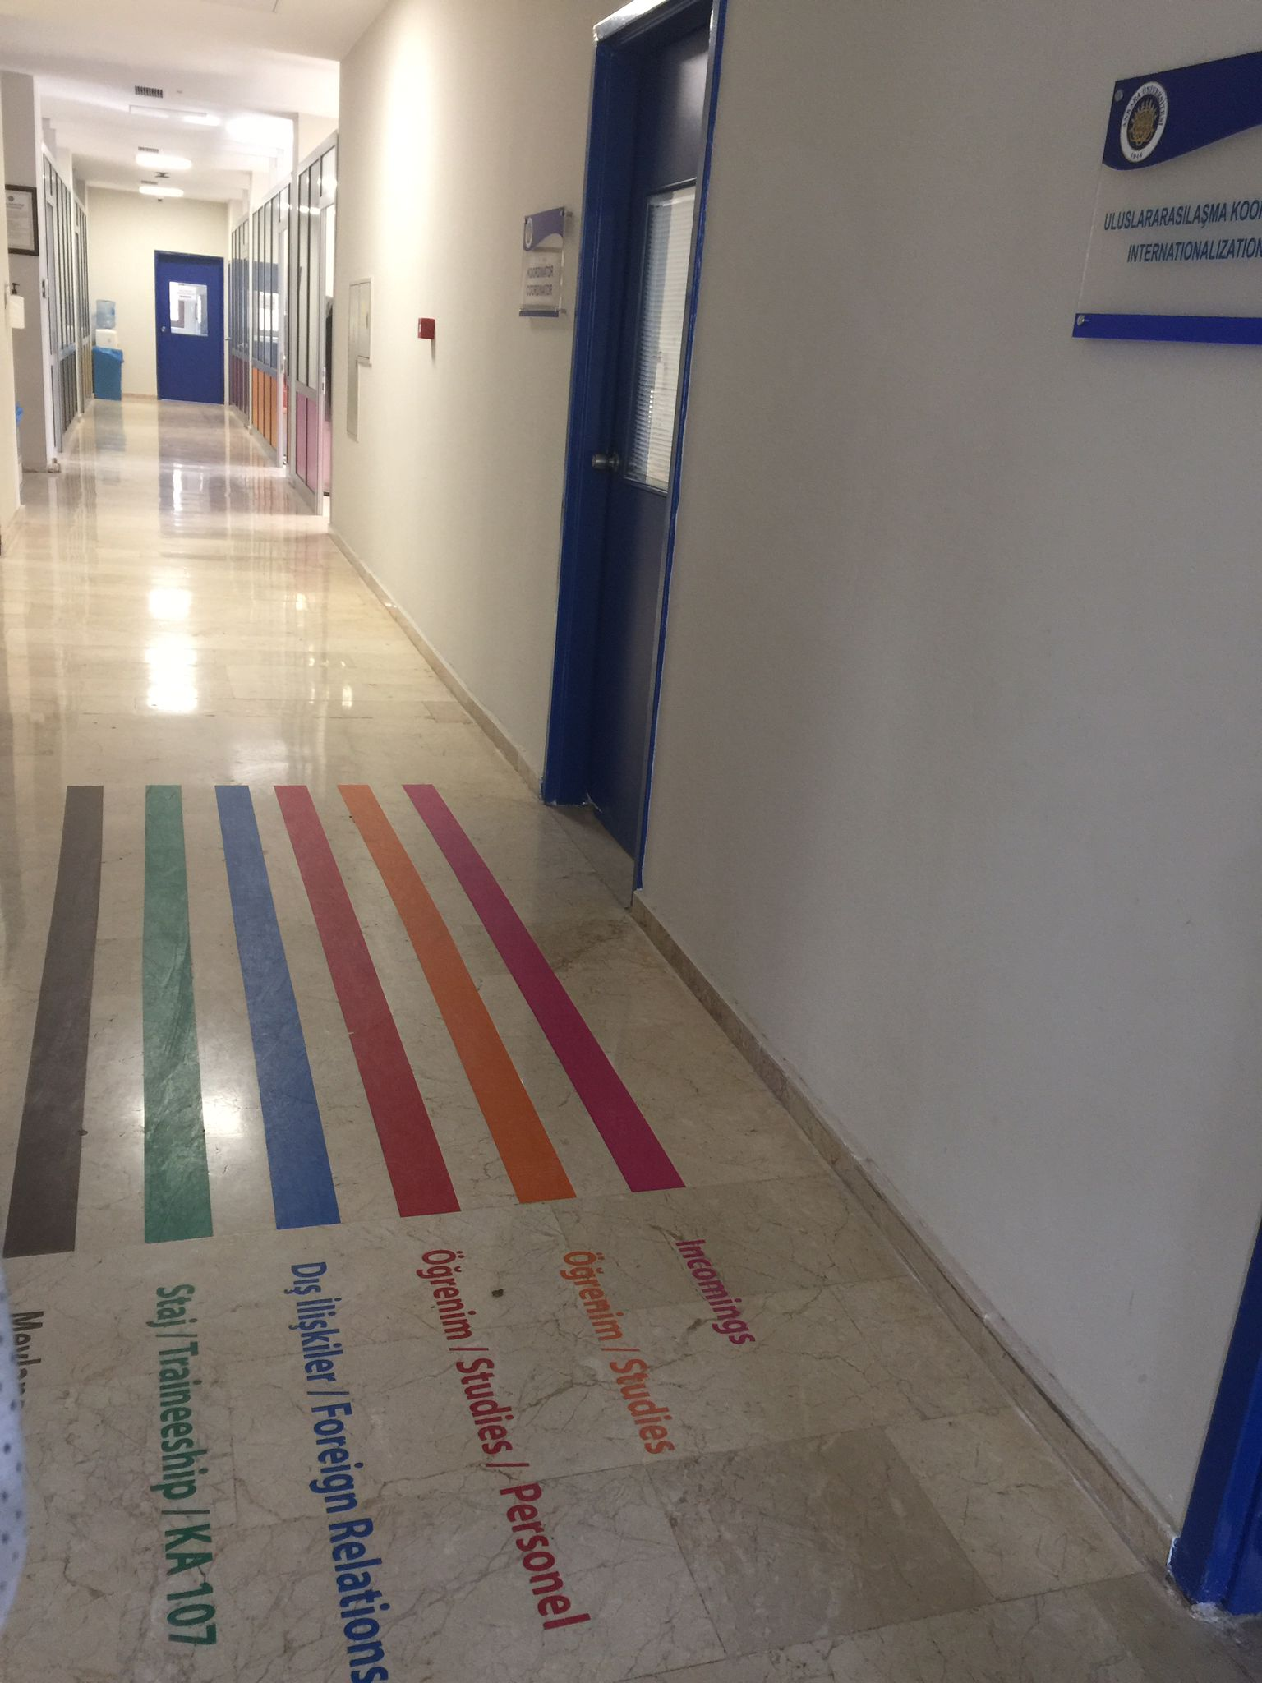

Slide 5



OFFICE ıs Ready to Help You
Turkish Language Course
TÖMER (Turkish Language Course): One Month Free, OFFICE WILL PAY FOR YOU. If you wish to extend the course duration, please contact with us. We will inform TÖMER about you.
Go to TÖMER Kızılay Branch to enroll.
Address:Kızılay, Ziya Gökalp Cd. No:18 D:1, 06420 Çankaya/Ankara
ESN will give you detail information in their presentation.

Slide 6


OFFICE ıs Ready to Help You
Education
Course Registration Form: The form that we already sent you by e mail. Fill in the form with your departmental coordinator. Be sure signed by departmental coordinator and you. Send it by e-mail or bring it by yourself to Office.
Arrival and Departure Documents
You can come to Office or send the document by e mail
Transcripts
Office will send you by email at the end of the term

Slide 7
HOW TO REACH DEPARTMENTAL COORDINATORS
http://www.erasmus.ankara.edu.tr
Coordinators Section
You can mail them about your classes, take appointment for face to face discuss

Slide 8

OFFICE ıs Ready to Help You
WiFi and Student ID:
- Student ID cards are ready.
- Save your student number and OBS password.

Slide 9
STUDENT RESIDENCE PERMIT REQUESTED DOCUMENTS 1
REQUESTED DOCUMENTS (COMMON)
Residence Permit Application Form (must be signed by foreigner and/or his/her legal representative.)
Photocopy of passport or passport substitute document (pages containing identity information and photo and pages processed) (The original document must be presented on the appointment day.)
Four (4) pcs biometric photos (must have been taken within the last 6 months, against a white background and biometric)
Document/receipt for the payment of residence permit card fee (For those who study at international organization, embassy and consular schools, a residence permit fee document/receipt shall also be required.)
Valid health insurance (Insurance period must cover the duration of the intended residence permit. One of the following document is considered sufficient):
    E-signed/signed and stamped/sealed document to be obtained from provincial social security units which states that the foreigner is benefiting from the health services in Turkey within the scope of bilateral social security agreements o E-signed/signed and stamped/sealed provision document to be obtained from the Social Security Institution-SGK (Provision documents to be obtained from SGK must cover both the sponsor and family members for family residence permits.)
    E-signed/signed and stamped/sealed document regarding the application made to the Social Security Institution to become a general health insurance holder o Private health insurance (Please submit the signed and stamped/sealed original of your insurance policy during application!)
Document of Residence
(One of the following document is considered sufficient.) o If you are staying in your own home, a photocopy of the title deed; ("residence document" is sufficient for extension applications.)
    If you are staying in a rental house on a rental agreement, a notarized copy of your rental agreement; o If you are staying at a hotel, etc. proof of your stay in these places; o If you are staying in a student dormitory, e-signed/signed and sealed/stamped
document showing that you are staying in the dormitory.
    If you are staying in a third person’s residence, the notarized undertaking of the
host (if the host is married, also the notarized undertaking of the spouse)

Slide 10
STUDENT RESIDENCE PERMIT REQUESTED DOCUMENTS 2
DOCUMENTS ACCORDING TO THE REASONS OF STUDENT RESIDENCE PERMIT STAY
Primary schoool (1 year)
  Visa conforming to the reason of stay to be obtained from the foreign representations of the Republic of Turkey (only for primary and secondary education) Secondary school (1 year)
  Visa conforming to the reason of stay to be obtained from the foreign representations of the Republic of Turkey (only for primary and secondary education) High school (1 year)
  Visa conforming to the reason of stay to be obtained from the foreign representations of the Republic of Turkey (only for primary and secondary education) Military High Schools (1 year)
  Visa conforming to the reason of stay to be obtained from the foreign representations of the Republic of Turkey (only for primary and secondary education)
Those studying in schools not affiliated with MEB (1 year) (international organization, embassy and consulate schools) (subject to fee)
• Visa conforming to the reason of stay to be obtained from the foreign representations of the Republic of Turkey (only for primary and secondary education) Associate’s degree (2 years)
Common Documents
Bachelor’s Degree (4 years)
Common Documents
Bachelor’s Degree – Dentistry/Pharmacy/Veterinary Faculties (5 years)
Common Documents
Bachelor’s Degree – Medical Faculty (6 years)
Common Documents
Military Academies (4 years)
Visa conforming to the reason of stay to be obtained from the foreign representations of the Republic of Turkey (only for primary and secondary education)
Master’s Degree (2 years)
Common Documents
Doctor’s Degree (3 years)
Common Documents

Slide 11
STUDENT RESIDENCE PERMIT REQUESTED DOCUMENTS 3
EXPLANATIONS
In case students request, valid health insurance shall not be requested as they are covered by general health insurance within three months from the date of registration, but they must notify the administration after taking out general health insurance within three months.
Upon the request of the administration, e-signed/signed and sealed/stamped student documents to be obtained from the institution where the education is received, or from the e-government system must be submitted.
If you could not graduate during the normal education period, a residence permit for a maximum of 1 year could be issued at a time for each year upon the submission of a student certificate proving that you could actively benefit from student rights.
During your residence permit period; in case you continue to study in a different faculty/department of the same university or transfer to a different university in the same province, you must report your situation to the provincial directorate of migration management within 20 working days in order to update your information, provided that there is no interruption in your student status.
If there is a change of university, faculty or department in a different province, you must apply for a residence permit to the provincial directorate of migration management in the province where your new university is located within 10 days. All your procedures shall be concluded by the provincial directorate of migration maagement in the province where your new university is located.
For children
If the mother and father could not be determined from passport or passport substitute document or national identity card, a certified birth certificate shall be requested.
In the absence of either mother or father, a certified deed of consent shall be requested. (In case of death of one of the parents, the other spouse is required to submit a certified death certificate.)
In case of divorce, a certified custody document of the child shall be requested.
(These documents must be e-signed/signed and sealed/stamped if obtained from Turkish authorities; they must have a notarized Turkish translation and an Apostille if obtained from abroad. It is required to be a citizen of a country which is a party to the Apostille Convention; or if there is no Apostille on the document even if the country is a party, the documents in question are required to be approved by the relevant country authoties (approval by the consulate/embassy and Ministry of Foreign Affairs/Turkish Authorities authorized on this issue).
If the foreigner in question is under eighteen years old, a certified deed of consent by mother/father abroad or legal representative, and a notarized undertaking by real or legal persons in Turkey, provided that it is specified in the deed of consent, shall be requested. v For transfer applications
Photocopy of the previous residence permit document shall be attached to application document. (The original document shall be submitted to the administration on the appointment day)

Slide 12
STUDENT RESIDENCE PERMIT REQUESTED DOCUMENTS 4
Those Who Receive Specialization Training in Medicine/Exam for Specialization in Medicine (TUS) (3 years)
Document proving TUS
Those Who Receive Specialization Training in Dentistry/Exam for Specialization in Dentistry (DUS) (3 years)
Document proving DUS
Those who are directed to a Turkish course by their university (1 year)
E-signed/signed and stamped/sealed document proving the education to be taken from the institution or organization authorized to provide Turkish language course (duration of the course must be specified)
Students arriving within the scope of Erasmus Programme (1 year)
E-signed/signed and stamped/sealed document proving "the exchange program" to be taken from the education institution
Those arriving within the scope of other international exchange programs (1 year)
E-signed/signed and stamped/sealed document proving "the exchange program" to be taken from the education institution
After all documents are completed, you need to take the documents to the “News from Department of Student Affairs” unit at Ankara University Beşevler 10th Year Campus, Şevket Aziz Kansu Building Floor: 3 Beşevler/Ankara.
Student document and health insurance document will be given from the Erasmus Office.

Slide 13
ResponsIble Person From Erasmus ıncomıng Students
Türkan Nagehan TEMİRCAN
E-mail: erasmus@ankara.edu.tr
Tel: +90312 212 60 40/2099
International Center-Erasmus Office
Orange Room

Slide 14


contact
Web address: erasmus.ankara.edu.tr
E-mail: erasmus@ankara.edu.tr
- For all the problems you have, please contact us with e-mail.
- If you need to come for a document, please take an appoitment.

Slide 15


Socıals
Instagram: Ankara Uni Erasmus Office/@ankaraunieu
Twitter: Ankara Uni EU/@ankara_uni
ESN
@esnankarauni

Slide 16




