Slide 1

Ankara University
The First University of Republic of Türkiye

Slide 2
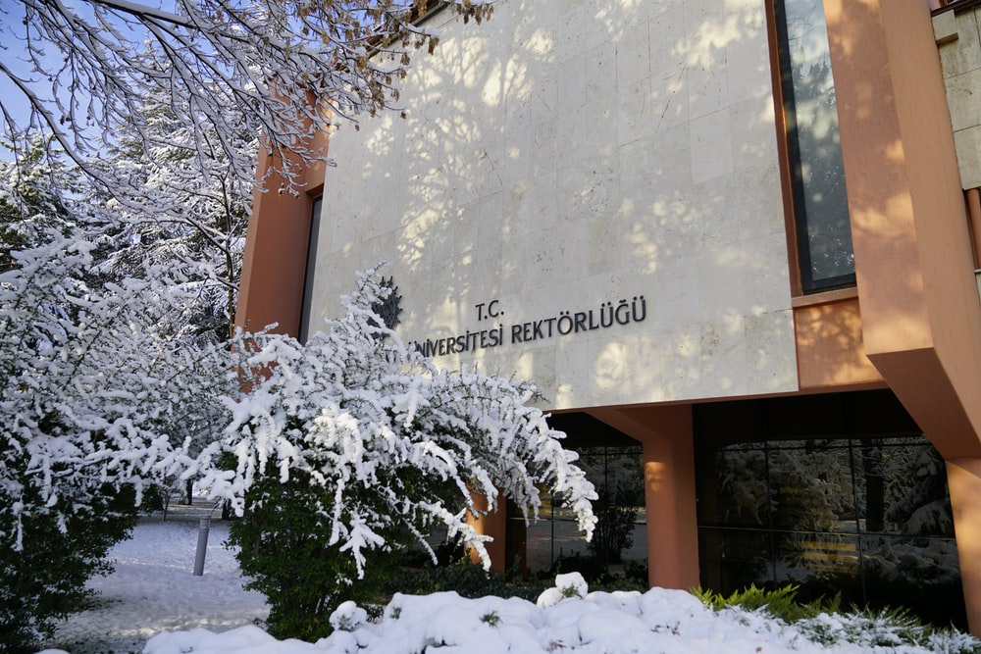
Ankara University is the first university of Republic of Turkiye;
officially established in 1946.

Slide 3
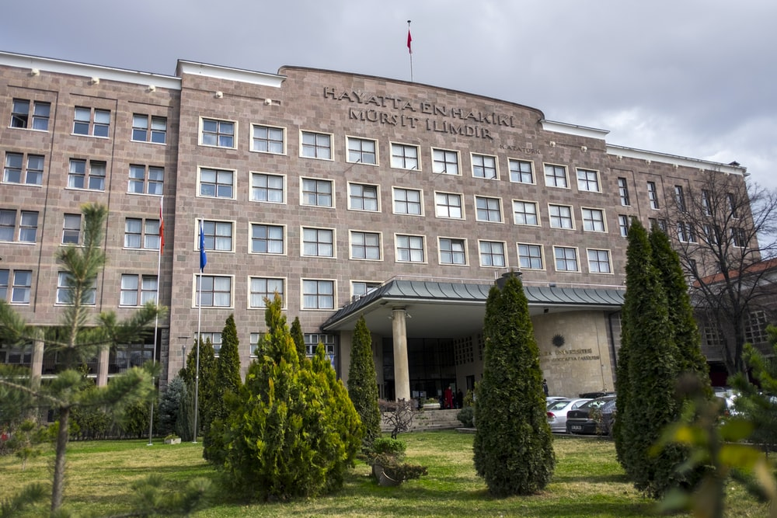

It is among the Research Universities that were selected by The Council of Higher Education in Türkiye

Slide 4
Rankings
International Rankings
URAP | 770
Webometrics | 717
ARWU | 850
CWUR | 652
LEIDEN | 643
QS | 900
RUR | 503
SCIMAGO | 671
USNews | 689
THE | 1201

Slide 5

Ankara University in Numbers
47 Research Centers
19 Faculties
13 Vocational Schools
15 Institutes
1 State Conservatory
1 School of Foreign Languages
Notes:
List of Vocational Schools
https://www.ankara.edu.tr/dizin/myo/
List of Institutes
https://www.ankara.edu.tr/dizin/enstituler/
List of Research Centers
https://www.ankara.edu.tr/dizin/merkezler/

Slide 6

Staff and Students in Numbers
8.026 Staff
4.320 Academic Staff
71.888 Students Enrolled
(4.578 International Students)

Slide 7
Faculties
Faculty of Political Science (1859)
Faculty of Veterinary Medicine (1842)
Faculty of Law (1925)
Faculty of Agriculture (1930)
Faculty of Language, History and Geography(1935)
Faculty of Science (1943)
Faculty of Medicine (1945)
Faculty of Divinity (1949)
Faculty of Pharmacy (1960)
Faculty of Educational Sciences (1965)
11.Faculty of Communication (1965)
Faculty of Dentistry (1977)
Faculty of Health Sciences(1990)
Faculty of Engineering (1992)
Faculty of Sport Sciences (2013)
Faculty of Fine Arts (2015)
Faculty of Applied Sciences (2015)
Faculty of Nursing (2017)
Faculty of Open and Distance Education (2020)

Slide 8
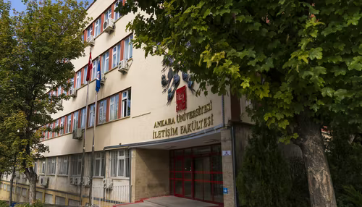

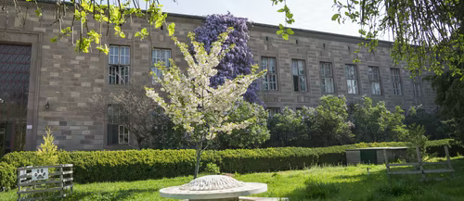
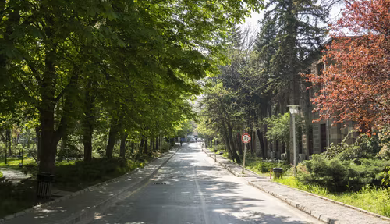

Slide 9
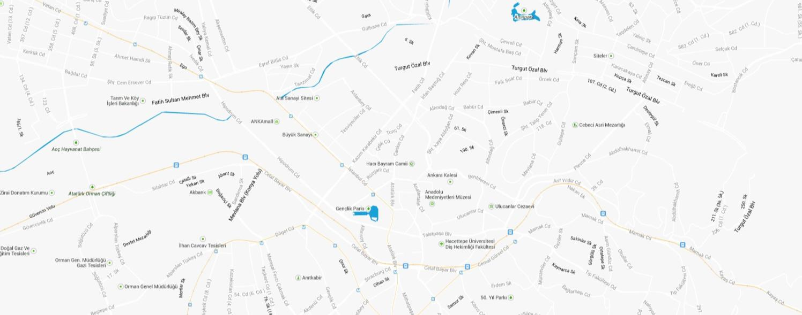
Ankara University: A Metropolitan University
Cebeci Campus
Political Sciences
Sıhhiye Campus
Humanities & Letters
Dışkapı Campus
Agriculture
Tandogan Campus
Gölbaşı Campus
Law
Educational Sciences
Communication
Health Sciences
Applied Sciences
Nursing
Divinity
Science
Pharmacy
Dentistry
Open and Distance Education
Medicine
Veterinary Medicine
Fine Arts
Sports Sciences
Engineering
School of Foreign Languages

Slide 10
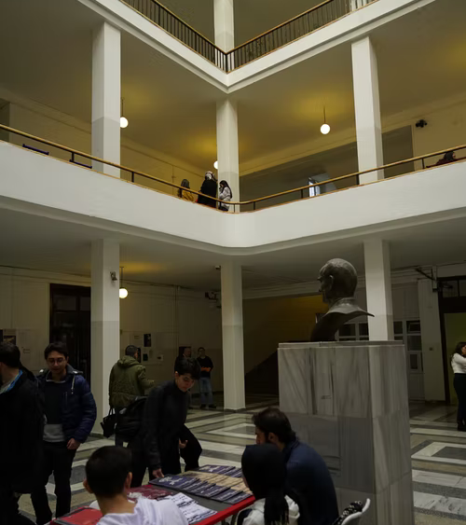
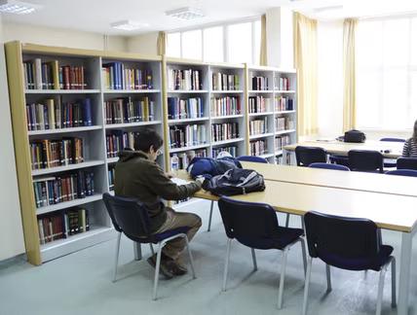
In our university, Turkish is the primary medium of instruction, but there are over 50 programs that are conducted entirely in English.

Slide 11
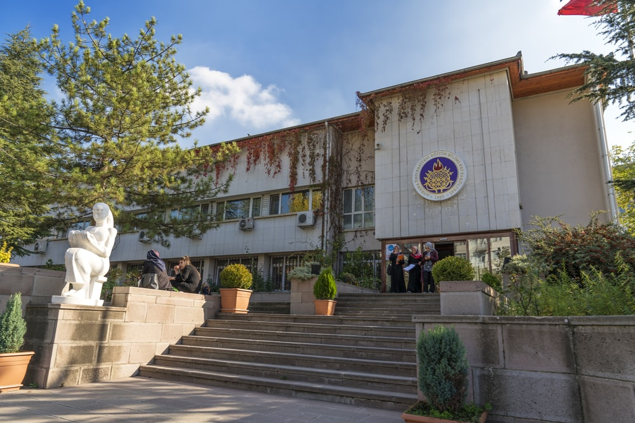
Internationalisation
Ankara University sends the highest number of students abroad with education and internship mobility within the scope of Erasmus+ Exchange Programs.
553 agreements with 29 countries and 298 different higher education institutions have been signed.
205 academic cooperation protocols have been signed with universities all around the world.

Slide 12
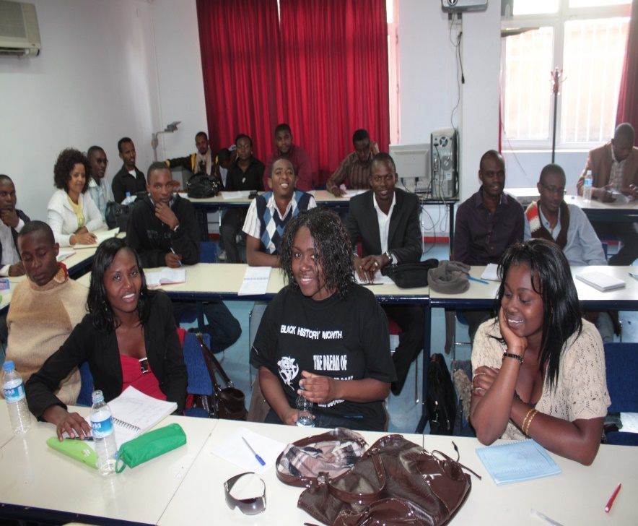
Internationalisation
Approximately 4.578 foreign students from 132 countries are studying at Ankara University.
The medium of instruction of 24 undergraduate programs, 26 master’s programs and 5 doctoral programs is English.
There are 24 different language programs at undergraduate, graduate and doctoral levels.
More than 70 foreign faculty members work at Ankara University.

Slide 13

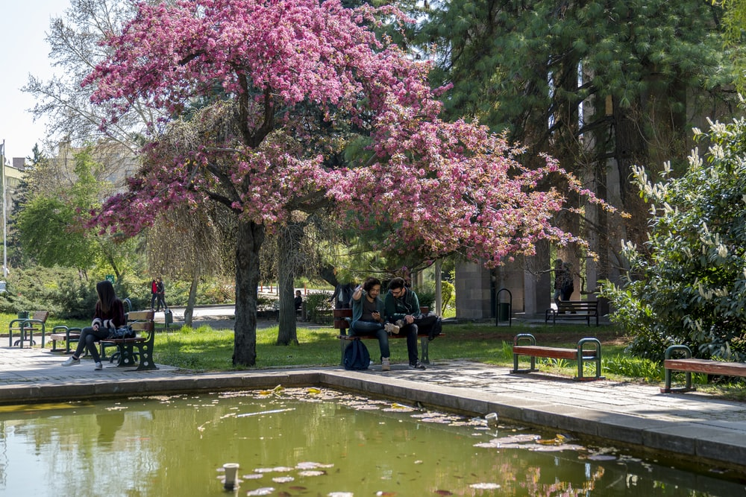
Internationalisation
Ankara University represents Türkiye and our University in Europe as a member of UNICA (European Capital Universities Association).
Center of Turkish and Foreign Languages Research and Application (TÖMER) was established in 1984 to teach Turkish to foreigners. The center offers courses in English, German, French, Spanish, Italian, Russian, Bulgarian, Japanese, Greek, Ottoman, Korean, Chinese, Arabic and Asian Turkic languages ​​besides Turkish.

Slide 14
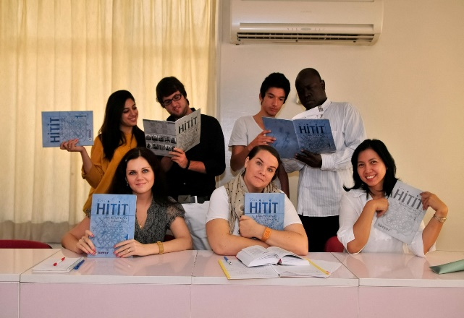
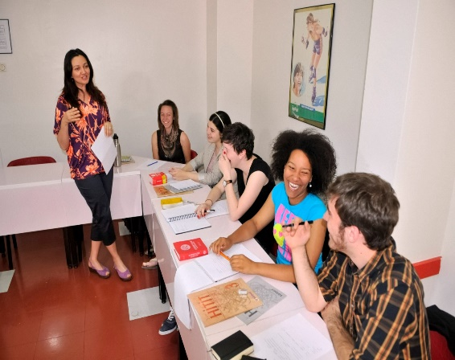

Center Of Turkish And Foreign Languages Research And Application (TÖMER)
11 branches around Türkiye
Approximately 55,000 students per year

Slide 15
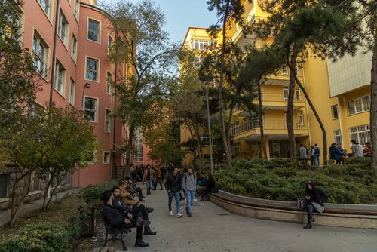
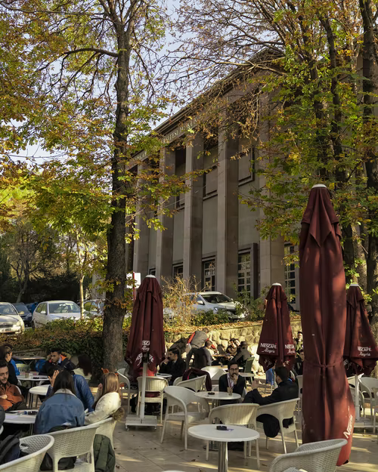
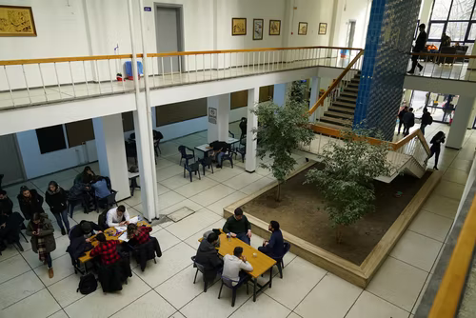
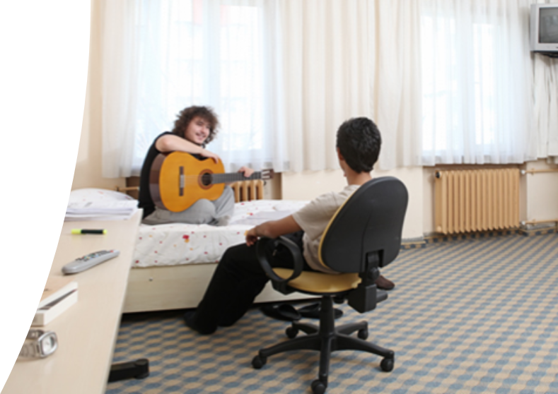
Social Life
Fully furnished dormitories and guest houses, social & recreational activities.
230 student communities.

Slide 16
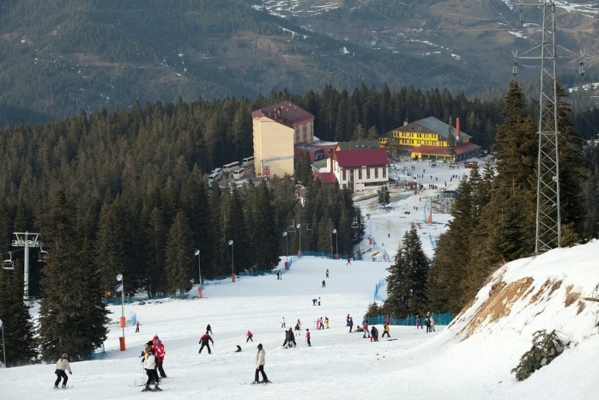
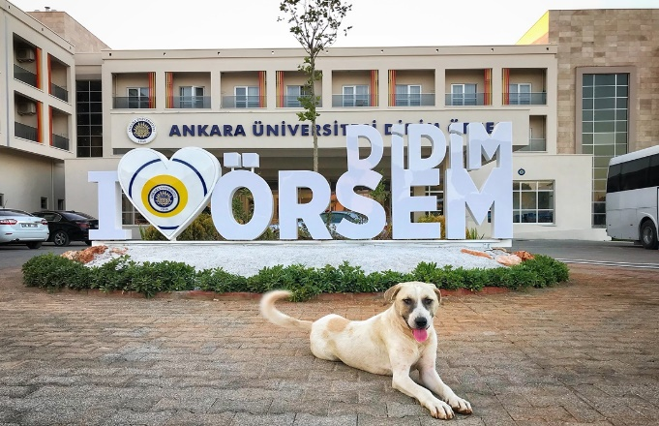
Social Life
The Mountain Resort At Mount Ilgaz
The Water Sports Center At Lake Mogan, Ankara
The Summer Training & Recreation Centers On The Mediterranian And Aegean Coast

Slide 17
Thank you for attention.
Notes:
Ara yüz, template konusunda teknik destekleri için Mehmet bey, Aslı ve Sevgi hanıma teşekkür ederim.

